Slide 1
ARG Matching and Modeling

Slide 2


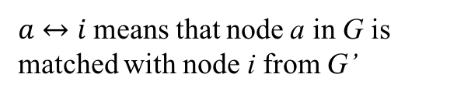

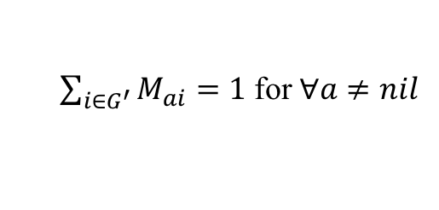
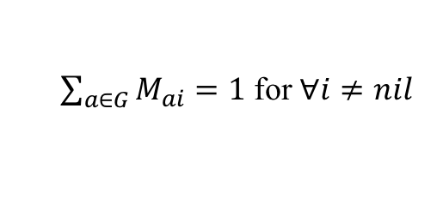
Mathematic Formulation
The energy of matching two ARGs $G$ and $G^{′}$ is defined as
$$E\left(G,G^{′},M\right)=−\frac{1}{2}\sum_{a∈G}{\sum_{b∈G}{\sum_{i∈G^{′}}{\sum_{j∈G^{′}}{M_{ai}M_{bj}C(a↔i,b↔j)}}}}−α\sum_{a∈G}{\sum_{i∈G^{′}}{M_{ai}C(a↔i)}}$$
Subject to:
$$M≥0$$
Both G and G’ contain a nil node.
$\sum_{i∈G^{′}}{M_{ai}}=1$ for $∀a≠nil$
$a↔i$ means that node a in G is matched with node i from G’
$\sum_{a∈G}{M_{ai}}=1$ for $∀i≠nil$
$$C\left(a↔i,a↔i\right)=0$$
$$C\left(a↔i,b↔j\right)=C\left(b↔j,a↔i\right)$$

Slide 3







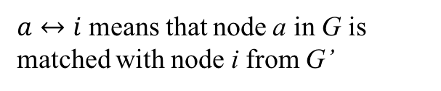

New Mathematic Formulation
The energy of matching two ARGs $G$ and $G^{′}$ is defined as
$$E\left(G,G^{′},M\right)=−\frac{1}{2}\sum_{a∈G}{\sum_{b∈G}{\sum_{i∈G^{′}}{\sum_{j∈G^{′}}{M_{ai}M_{bj}C(a↔i,b↔j)}}}}−α\sum_{a∈G}{\sum_{i∈G^{′}}{M_{ai}C(a↔i)}}$$
Subject to:
$$M≥0$$
Both G and G’ contain |G’| nil nodes and |G| nil nodes.
$\sum_{i∈G^{′}}{M_{ai}}=1$ for $∀a≠nil$
$a↔i$ means that node a in G is matched with node i from G’
$\sum_{a∈G}{M_{ai}}=1$ for $∀i≠nil$
$$C\left(a↔nil\right)>0$$
$M_{ai}$ = 0 for $∀a≠i+|G|$
$$C\left(nil↔nil\right)=0$$
$M_{ai}$ = 0 for $∀i≠a+|G′|$
$$C\left(a↔nil,b↔nil\right)>0$$
$$C\left(a↔i,b↔nil\right)=0$$
$$C\left(a↔i,a↔i\right)=0$$
$$C\left(a↔i,b↔j\right)=C\left(b↔j,a↔i\right)$$

Slide 4
New Mathematic Formulation
The energy of matching two ARGs $G$ and $G^{′}$ is defined as
$\frac{ΔE\left(G,G^{′},M\right)}{ΔM_{ai}}=−\sum_{b∈G }{\sum_{j∈G^{′}}{M_{bj}C(a↔i,b↔j)}}−αC(a↔i$)

Slide 5
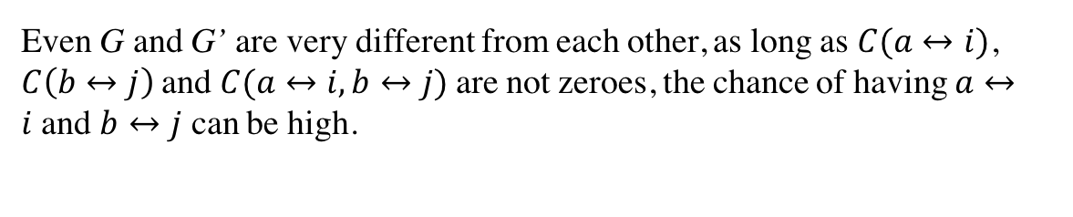
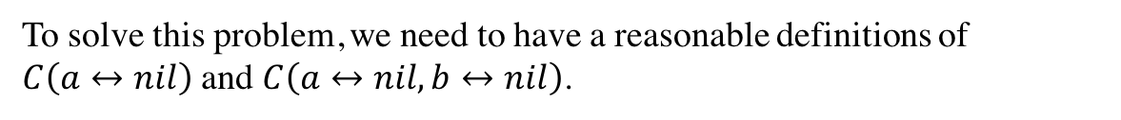
The Problem
G
a
b
nil
G’
i
j
nil
Even G and G’ are very different from each other, as long as $C(a↔i)$, $C\left(b↔j\right)$and $C(a↔i,b↔j)$are not zeroes, the chance of having $a↔i$and $b↔j$ can be high.
To solve this problem, we need to have a reasonable definitions of $C\left(a↔nil\right)$ and $C\left(a↔nil,b↔nil\right)$.

Slide 6
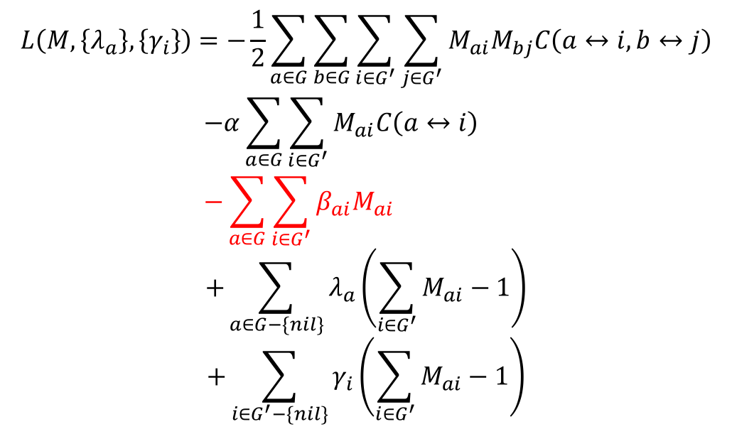
Solve Graph Matching
Use Lagrange multipliers to incorporate the constraints into the cost function.
$$L\left(M,\left\{λ_{a}\right\},\left\{γ_{i}\right\}\right)=−\frac{1}{2}\sum_{a∈G}{\sum_{b∈G}{\sum_{i∈G^{′}}{\sum_{j∈G^{′}}{M_{ai}M_{bj}C\left(a↔i,b↔j\right)}}}}$$
$$−α\sum_{a∈G}{\sum_{i∈G^{′}}{M_{ai}C\left(a↔i\right)}}$$
$$−\sum_{a∈G}{\sum_{i∈G^{′}}{β_{ai}M_{ai}}}$$
$$+\sum_{a∈G−\{nil\}}{λ_{a}\left(\sum_{i∈G^{′}}{M_{ai}}−1\right)}$$
$$+\sum_{i∈G^{′}−\{nil\}}{γ_{i}\left(\sum_{i∈G^{′}}{M_{ai}}−1\right)}$$
No more normalization and soft-assign?

Slide 7
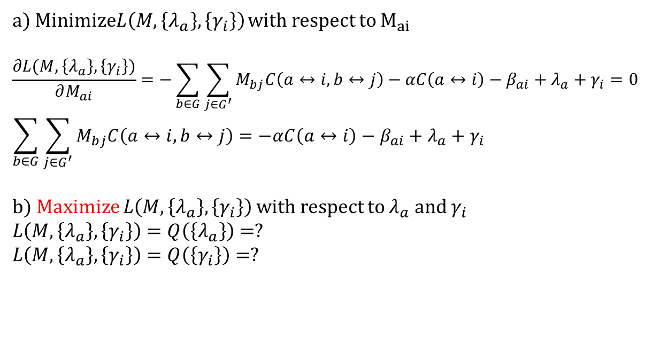
a) Minimize$L\left(M,\left\{λ_{a}\right\},\left\{γ_{i}\right\}\right)$ with respect to $M_{ai}$
$$\frac{∂L(M,\left\{λ_{a}\right\},\left\{γ_{i}\right\})}{∂M_{ai}}=−\sum_{b∈G}{\sum_{j∈G^{′}}{M_{bj}C\left(a↔i,b↔j\right)}}−αC\left(a↔i\right)−β_{ai}+λ_{a}+γ_{i}=0$$
$$\sum_{b∈G}{\sum_{j∈G^{′}}{M_{bj}C\left(a↔i,b↔j\right)}=−αC\left(a↔i\right)−β_{ai}+λ_{a}+γ_{i}}$$
b) Maximize $L\left(M,\left\{λ_{a}\right\},\left\{γ_{i}\right\}\right)$ with respect to $λ_{a}$ and $γ_{i}$
$$L\left(M,\left\{λ_{a}\right\},\left\{γ_{i}\right\}\right)=Q\left(\left\{λ_{a}\right\}\right)=?$$
$$L\left(M,\left\{λ_{a}\right\},\left\{γ_{i}\right\}\right)=Q\left(\left\{γ_{i}\right\}\right)=?$$

Slide 8
Sample ARGs
Component ARGs
Summarize Square Pattern
Summarize House Pattern

